Slide 1
Check Aging
By
SnowRebooters Team
Bhavani, Tommy, Ken, Norm
(special thanks to Josh Dockery)
April 12, 2019

Slide 2

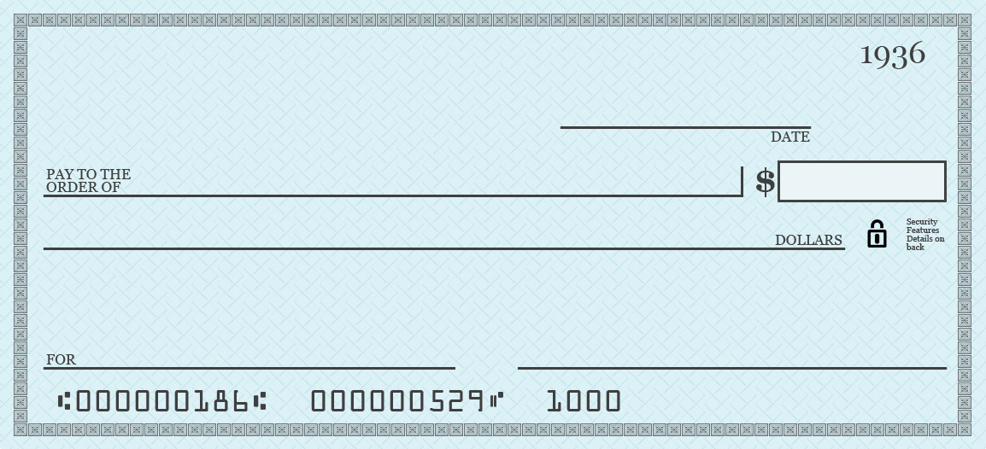
Background
Buyers tell Avid to pay suppliers
Avid sometimes pays by check
Avid builds a check image
image sent to Fiserv
Fiserv prints and mails
Supplier receives check
Gives check to bank
Bank provides cleared image

Slide 3
What is the problem?
moo
When checks are NOT CASHED, they become an albatross
Need a way to manage ISSUED and CLEARED checks
Provide information to suppliers and buyers about their checks.

Slide 4
Why track check aging?
Connection with the customer!
Build TRUST
Avidxchange appears proactive
Increase sales opportunities

Slide 5
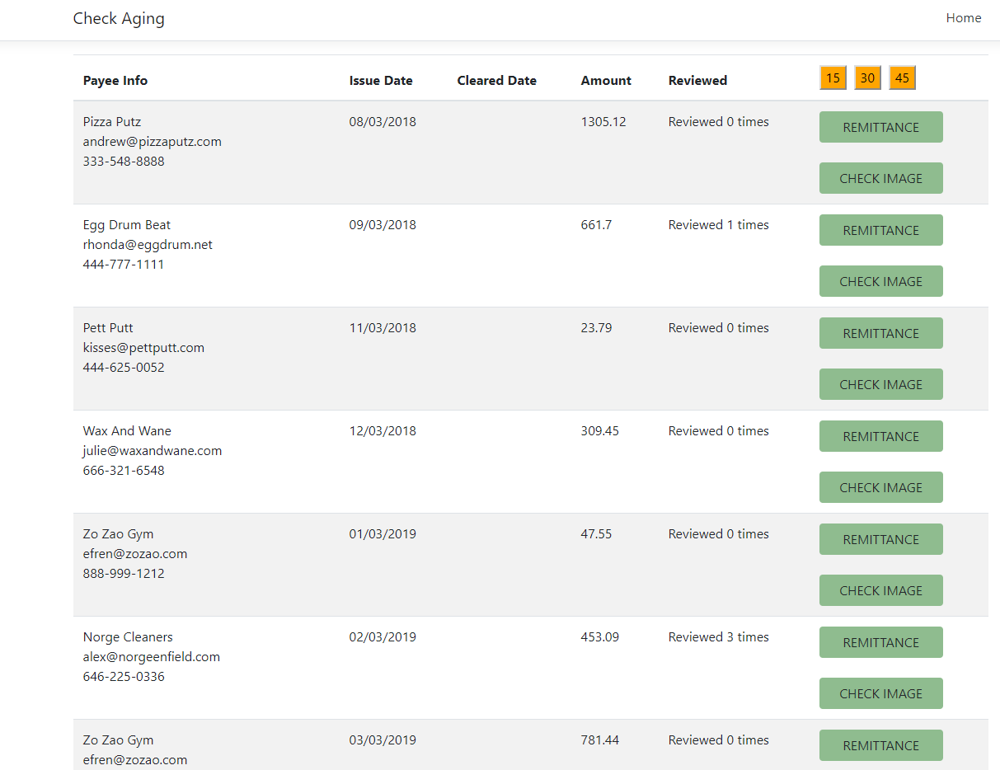
Check Aging Design
Payments + Checks
Buyers + Suppliers
.Net Core 3.0 with Angular
Avidpay DB
Cottonwood DB
Coalesce or Migrate
Azure
Check Aging Dataset
API

Slide 6
Technologies
Azure SQL Server & DB
GitHub
Angular
Visual Studio 2019
.Net Core 3.0 Preview
SendGrid

Slide 7
References
https://docs.microsoft.com/en-us/azure/sendgrid-dotnet-how-to-send-email
https://angularjs.org/
https://www.getpostman.com/

Slide 8
Demonstration

Slide 9
Lessons Learned
How to respond fast to customer requirements change
Improving Agile processes
Help us to scale 2-week sprint better

Slide 10
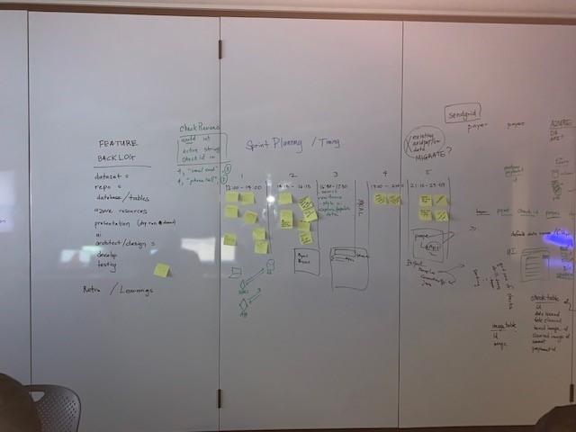
Planning

Slide 11
As a user:
As a user, I want to view all the checks in an issued date range regardless of cleared status.
As a user, I want to search for checks based on number of days as uncleared.
As a user, I want to view payers and payees contact information so I can contact them when it's necessary.
As a user, I want to notify the payee about a check that has not yet cleared.

Slide 12
Q & A

